Slide 1


UPSTATE NEW YORK REAL ESTATE
DATA ANALYSIS PRESENTATION
Ist 652 – scripting for data analysis Ischool @ Syracuse university JAMES R. INGRAM II SUMMER QUARTER 2018

Slide 2

Project overview
Objectives, Data Source, Data Extraction, Analysis Methods

Slide 3


Project objectives
Create a Python program that allows users to explore a data analysis problem
Create an easy-to-navigate user interface
Store files and figures generated by the program
Allow for future expansion
Primary objectives
Learn about present real estate market in Upstate New York by examining data on selected cities collected from a popular website
Utilize the following data analysis techniques:
Web scraping for data extraction
Exploratory Data Analysis
Linear regression model building
Comparative analysis
Secondary objectives

Slide 4

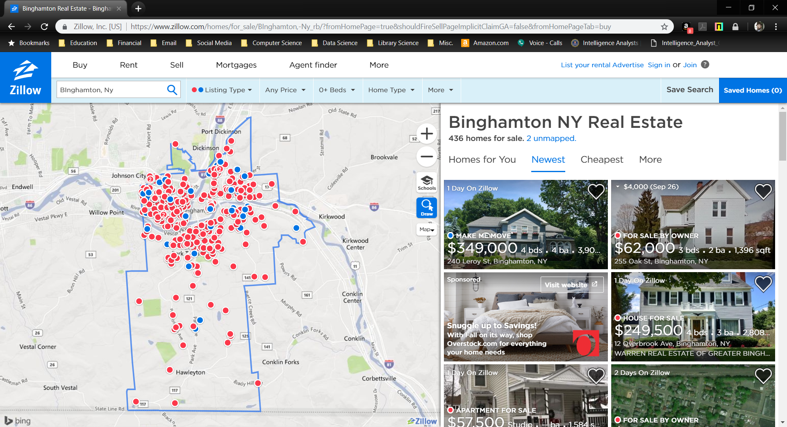
Data source
For this project, data was extracted from Zillow (https://www.zillow.com/), a popular real-estate website with a database containing over 110 million listings of homes in the United States.

Slide 5
Cities for analysis

Slide 6

Data extraction
Initial plan: scrape data from website Limitation: robots.txt Revised plan: download html files Extraction: Parse html with BeautifulSoup Limited number of variables Data cleaning steps Save data to .csv file

Slide 7
Analysis Methods
Exploratory Data Analysis & Regression Modelling

Slide 8
Exploratory data analysis
Variables extracted from Zillow, include:
Listing title
Address
City
State
Zip Code
Number of Bedrooms
Number of Bathrooms
Area (in square feet)
Price
Look at each variable and then examine relationships between them

Slide 9
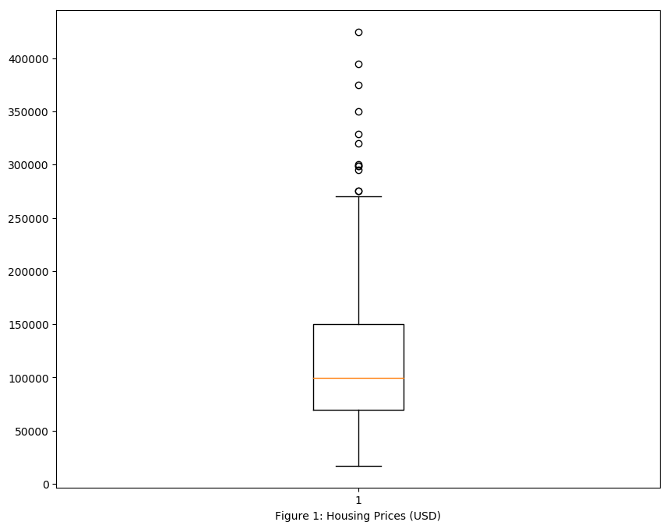
PRICING DATA EXAMPLE
HOUSING COSTS (BINGHAMTON, NY)
Minimum Price | $17,000.00
Mean Price | $121,174,51
Median Price | $99,500.00
Maximum Price | $424,900.00

Slide 10
Bedroom DATA EXAMPLE
NUMBER OF BEDROOMS (BINGHAMTON, NY)
Minimum Bedrooms | 1
Mean Bedrooms | 3
Median Bedrooms | 3
Maximum Bedrooms | 6

Slide 11
BATHROOM DATA EXAMPLE
NUMBER OF BATHROOMS (BINGHAMTON, NY)
Minimum Bathrooms | 1
Mean Bathrooms | 1
Median Bathrooms | 2
Maximum Bathrooms | 4

Slide 12
AREA DATA EXAMPLE
AREA (BINGHAMTON, NY)
Minimum Area | 700 ft²
Mean Area | 1879 ft²
Median Area | 1690 ft²
Maximum Area | 5322 ft²

Slide 13
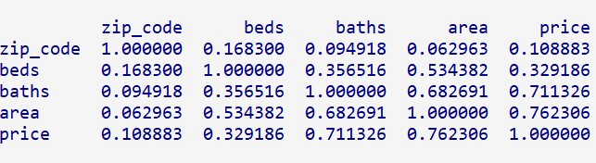
Correlation matrix

Slide 14
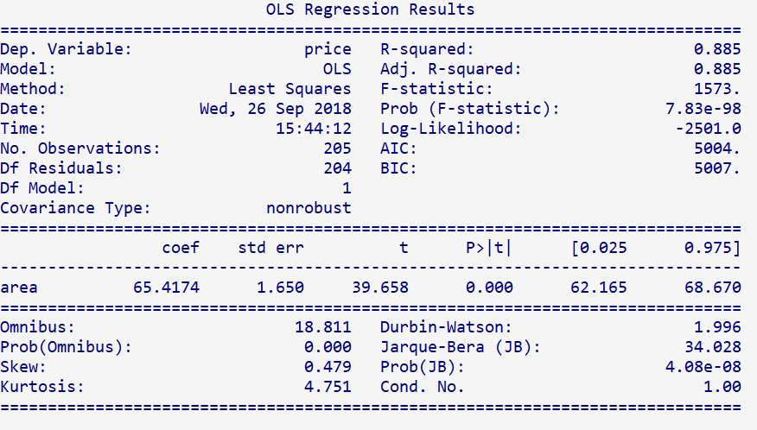
Linear regression

Slide 15
Comparison analysis
Examining Data for All Cities

Slide 16
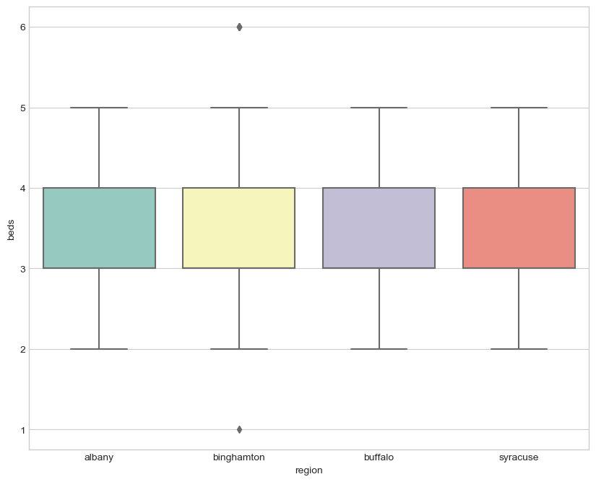
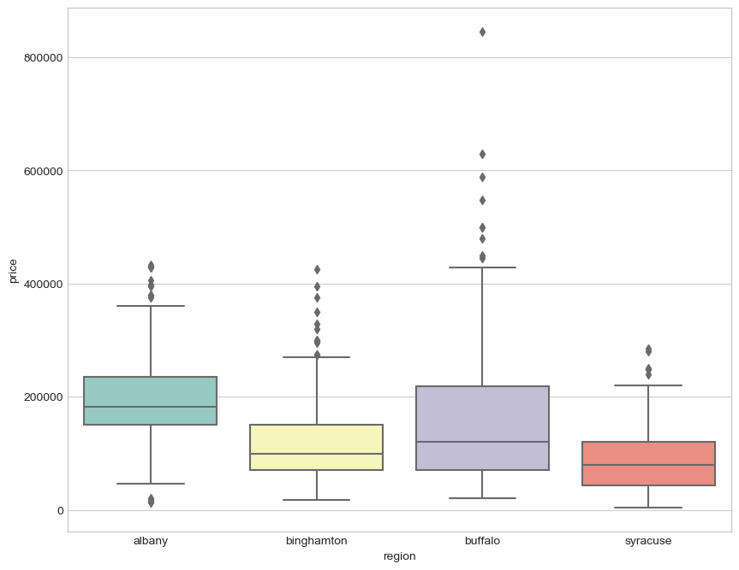
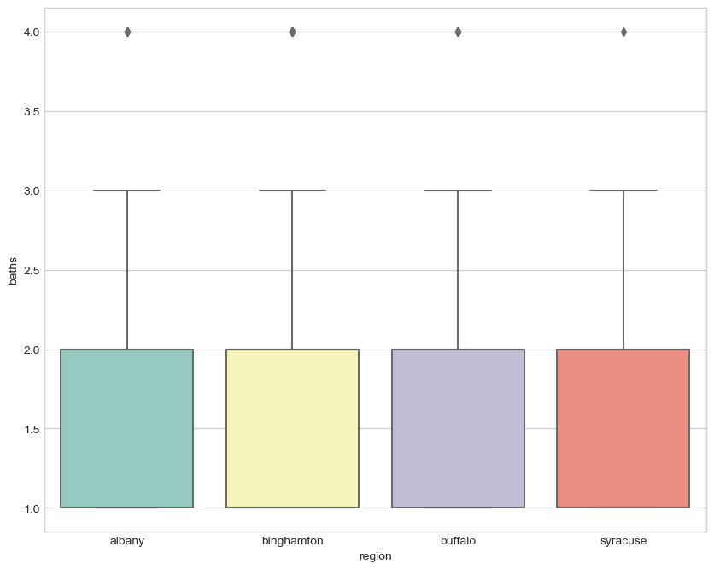
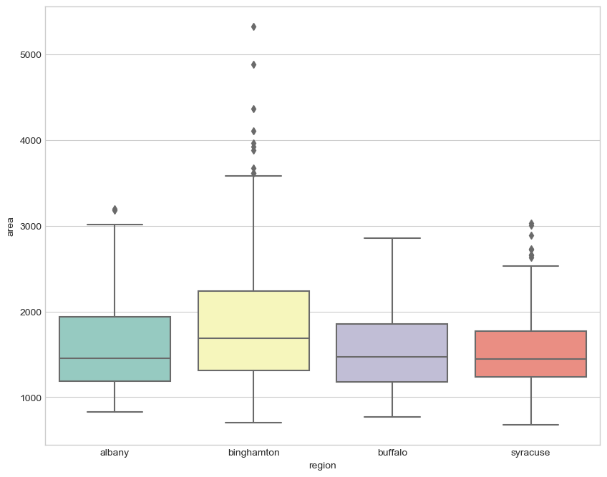
ALL FOUR CITIES (DATA COMPARISON)

Slide 17
ALL FOUR CITIES (DATA COMPARISON)
REGION | AVG. BEDS | DEVIATION | AVG. BATHS | DEVIATION | AVG. AREA | DEVIATION | AVG. PRICE | DEVIATION
Albany | 3 | 0 | 1 | 0 | 1,596 ft² | -28.25 | $191,151.34 | +$50,640.27
Binghamton | 3 | 0 | 1 | 0 | 1,879 ft² | +233.75 | $121,174.51 | -$19,336.56
Buffalo | 3 | 0 | 1 | 0 | 1,565 ft² | -80.25 | $162,735.17 | +$22,241.10
Syracuse | 3 | 0 | 1 | 0 | 1,541 ft² | -104.25 | $86,983.24 | -$53,526.83
AVERAGE | 3 | --- | 1 | --- | 1,645.25 ft² | --- | $140,511.07 | ---

Slide 18



Future research
Outside factors affecting price
Time-series data analysis
Population
Population Density
Average Income
Education Level
Poverty Level
Crime Rate
Etc.
Scraping html files results in date-stamped .csv files. The program can be run periodically, and trends in pricing could be plotted.

Slide 19
Program demonstration
A live walk-through of real_estate_scraper.py, real_estate_analyzer.py, and real_estate_compare.py

Slide 20

Thank you
jringram@syr.edu
https://www.jamesingram.tech

